Slide 1

TEAM CURIOSITY
BY KESEVAN SEKAR BALAJI & LOKESH K RAMDAS

Slide 2
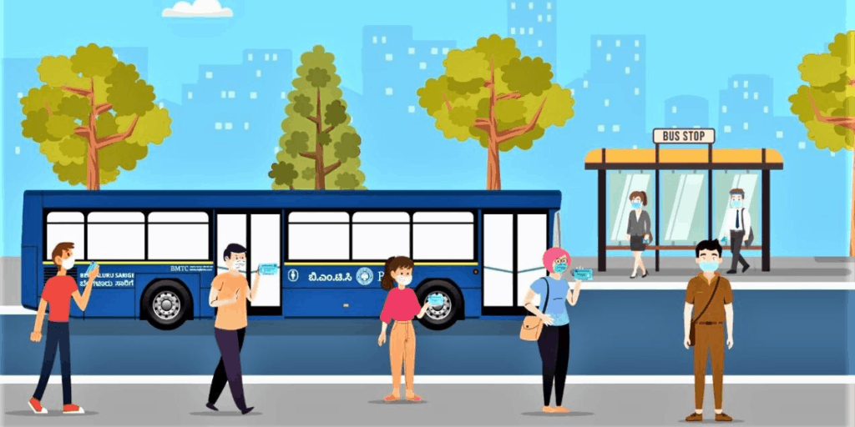
Problem Statement
In the Post Pandemic era, there will be a substantial decline in the usage of public transportation as more and more people will rely on their own vehicles or private taxi services.
Main goal is to encourage the use of public transport and bring back to it’s former pre-pandemic glory keep the new restriction in mind.

Slide 3
Solution
To design an app which given the input of
Route
Day
Time
Will give a list of available buses and the risk of infection for each based on the user input.

Slide 4
Real life Use
We can scale it up by using cloud as a database. Storing updated survey data of rush hours from the BMTC staff.
Additional Map features can also be included to provide better user experience.
An ML model can be deployed to predict future rush timing in routes.

Slide 5
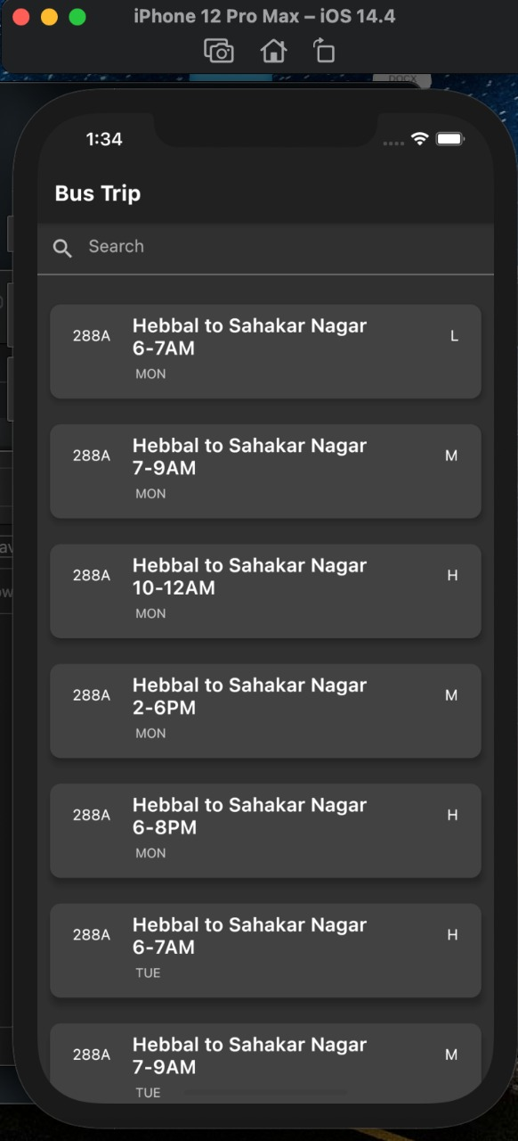
Implementation
Frontend UI – Flutter
For simplicity, we have implemented a simple search model.
The data is presented with Bus Number, Route, Time and the risk of infection (H-High,M-Medium,L-Low)

Slide 6
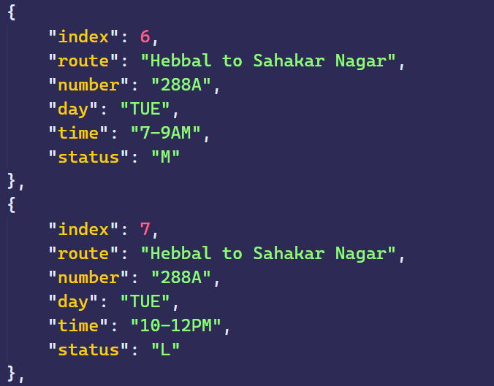
Data stored in JSON Format

